Slide 1

Iron Chef
A game of culinary carnage

Slide 2
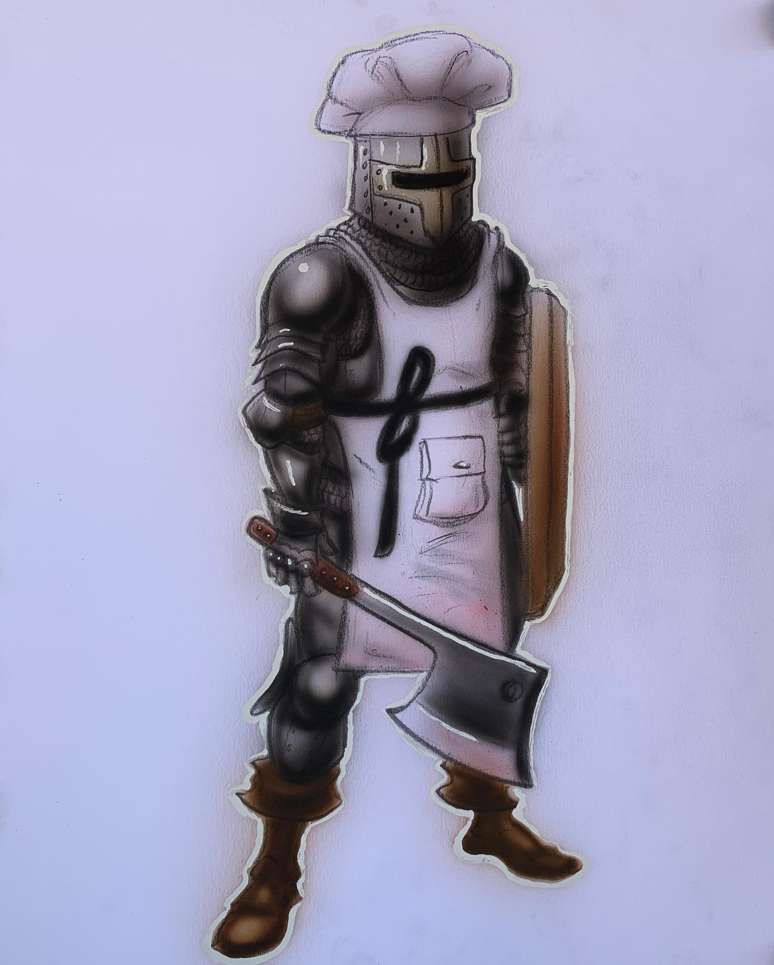
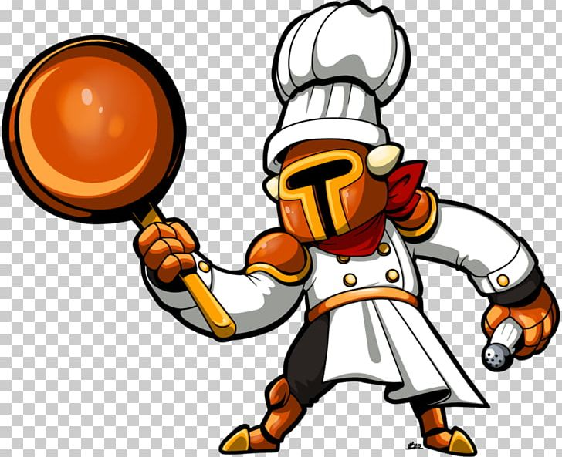
Iron Chef
Notes:
Take “cut the carbs” to a whole new level. Play as an iron-clad chef saving the Kingdom of Sustenance from food monsters. Take advantage of the situation to prepare the perfect meal with the freshest ingredients. Augment your gear using your fallen foes to better prepare yourself for food of ever increasing danger. In this world, it’s eat or be eaten, and the food is hungrier than ever.

Slide 3
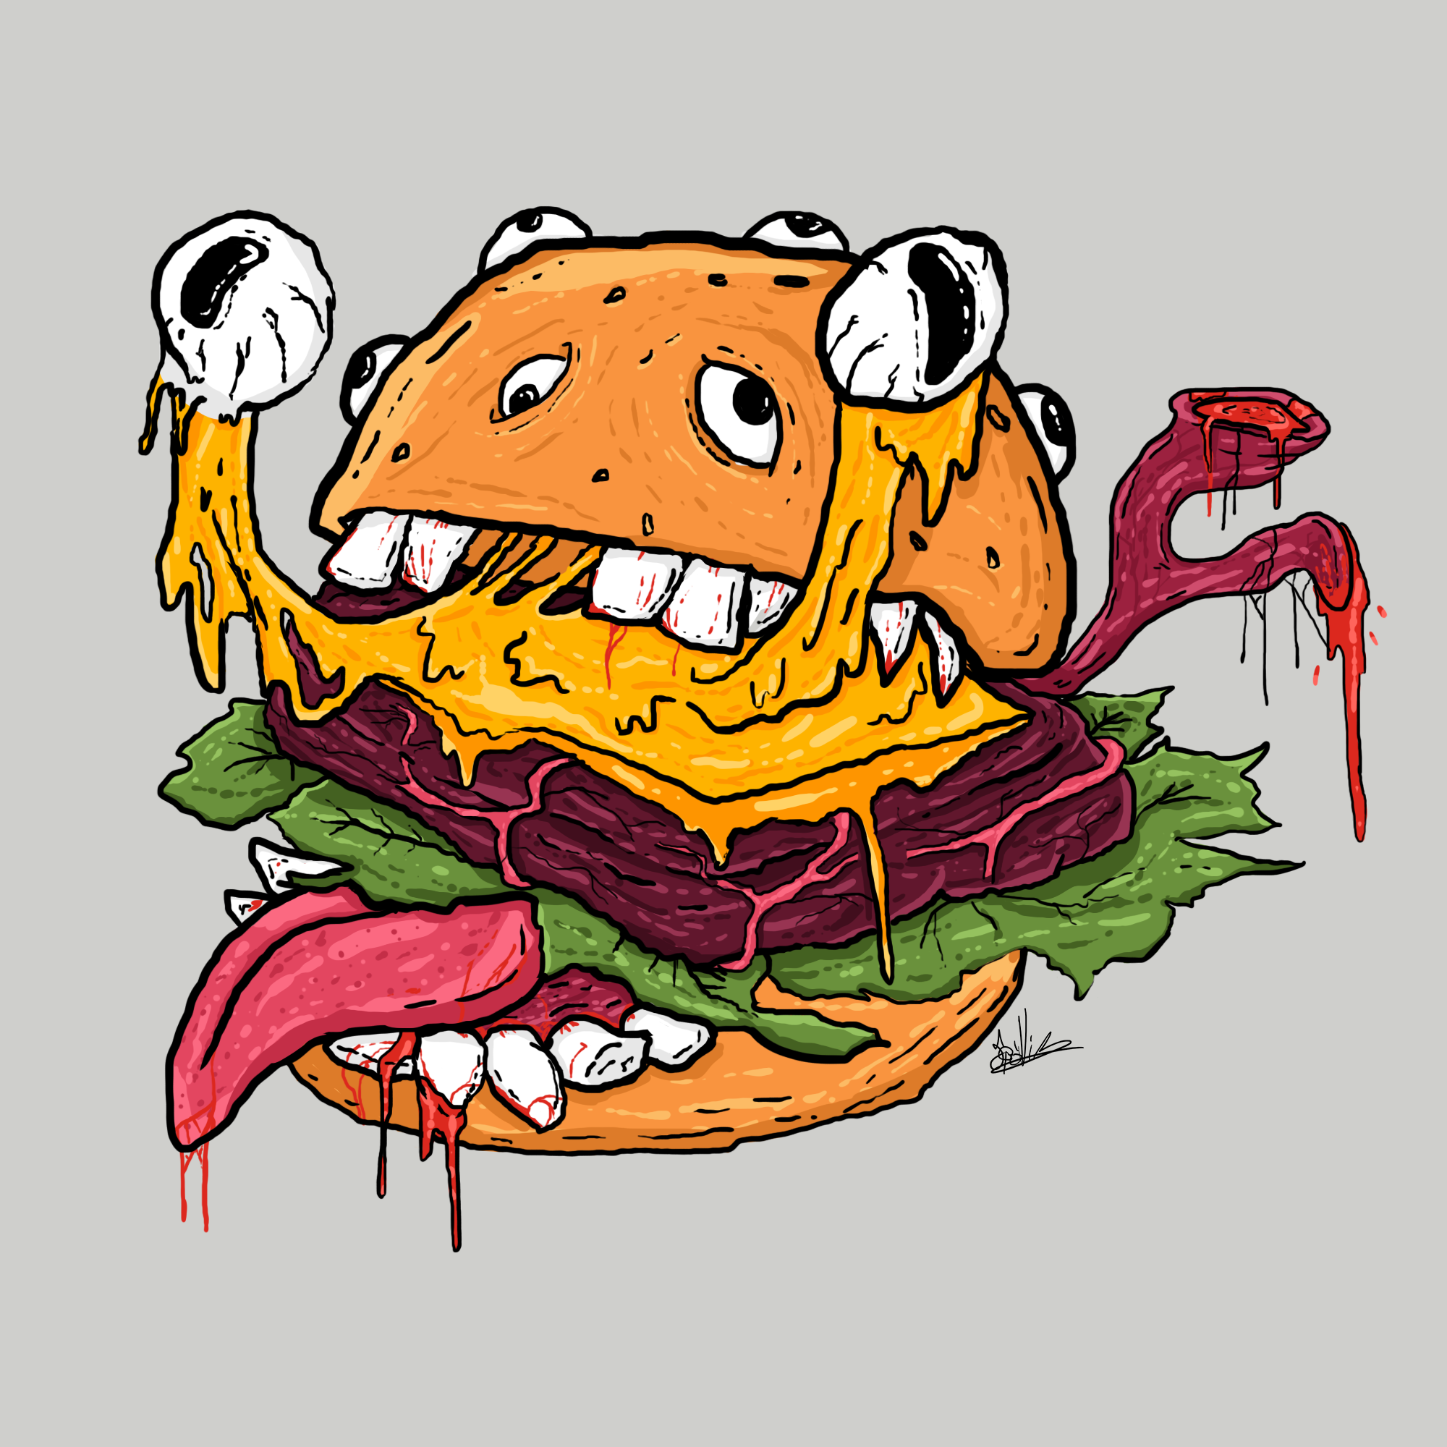
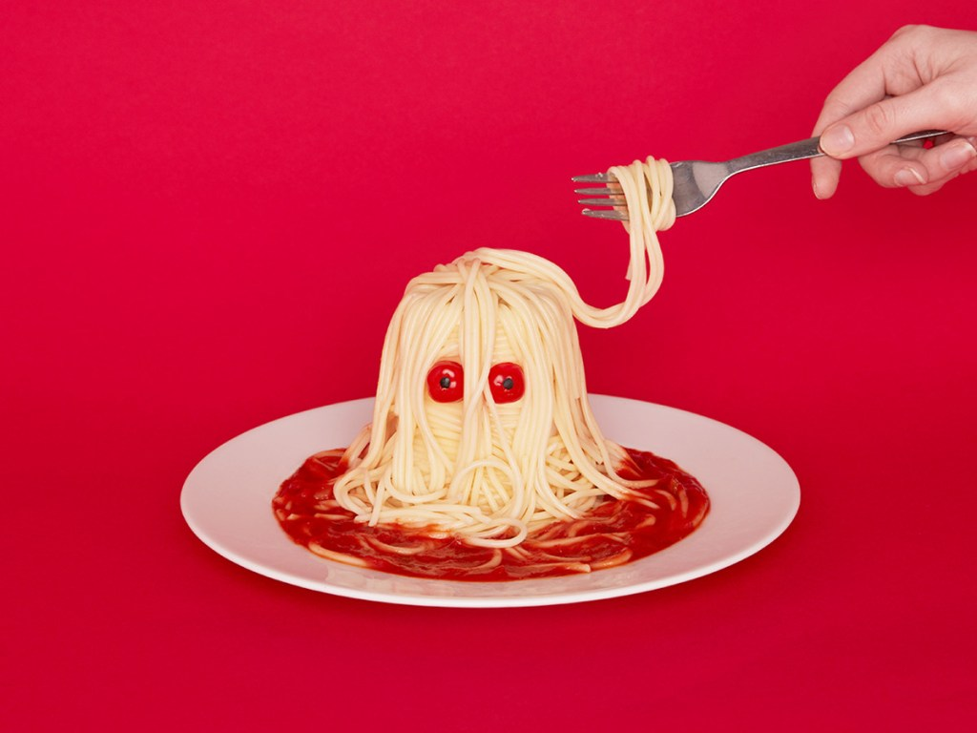
High Concept
Notes:
Defend the Kingdom of Sustenance as the Iron Chef, defeating food monsters that have invaded your homeland. Take advantage of the situation to make the most delicious and exquisite meals. Use your fallen enemies to create meals and give yourself extraordinary powers to defeat more powerful foods.

Slide 4


Gameplay/Mechanics
Gameplay Loop
Slay monsters and gather their ingredients
Obtain the correct ingredients for your dish
Avoid ingredients that don’t go in your dish
Defeat the boss ingredient
Obtain new powers
Verbs
Fight
Cook
Explore
Dodge
Augment
Move
Collect

Slide 5
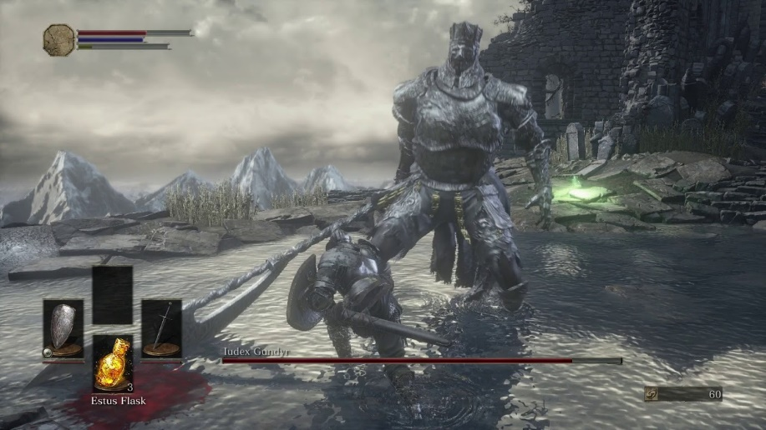
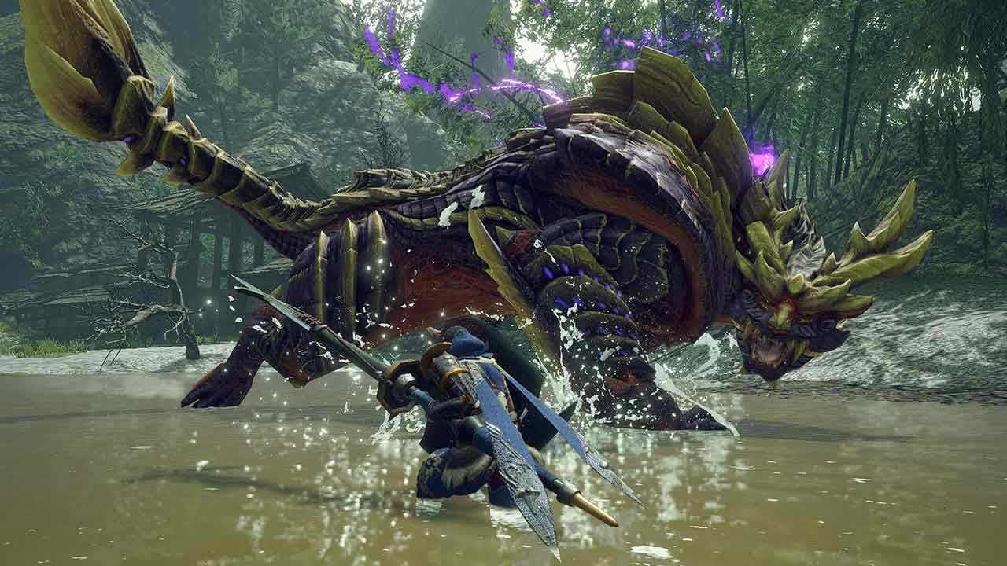
Similar Games

Slide 6
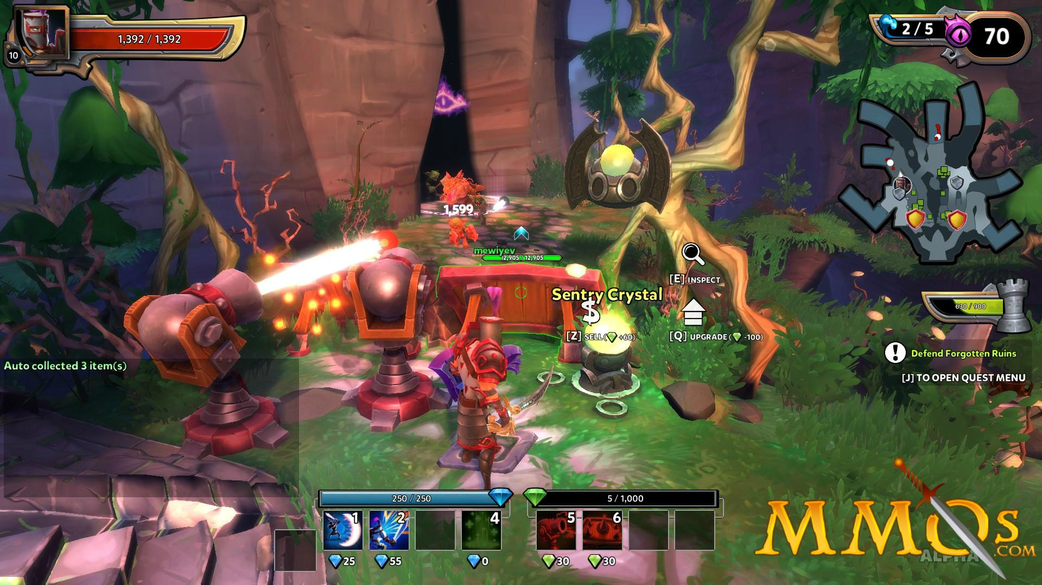
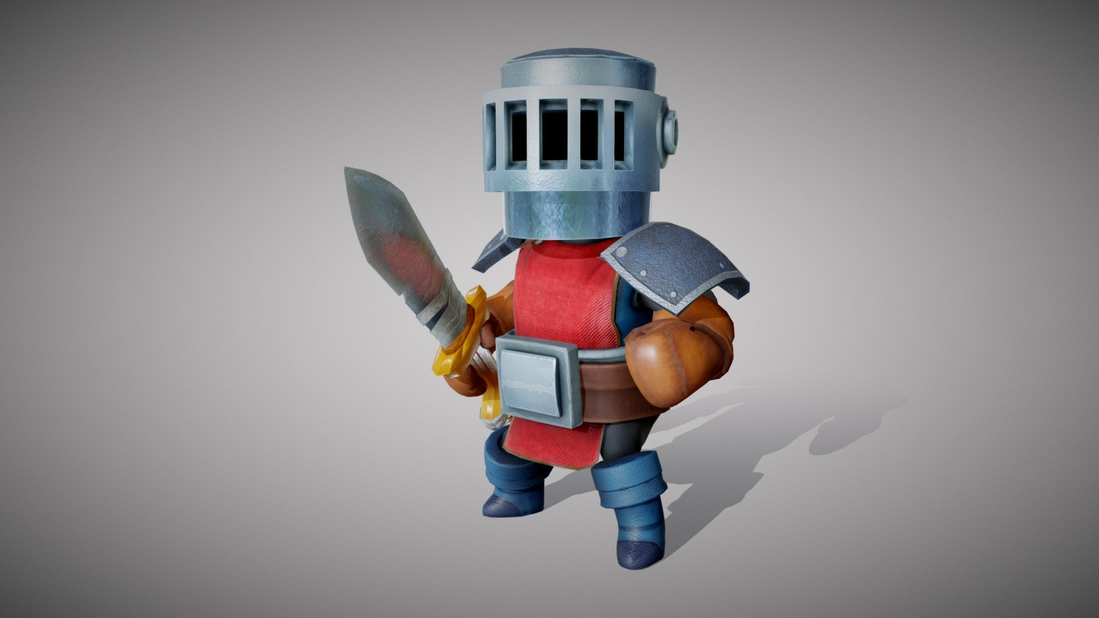
Aesthetic Style
3D game, Third Person Shooter Viewpoint
Bright/Cheery/Exciting
Whimsical, Non-serious nature
Simple!!
Notes:
The atmosphere is bright and optimistic, with a non-serious tone. The game’s concept and experience is more whimsical and silly than it is serious, so cartoony characters and exciting music should support this core experience

Slide 7
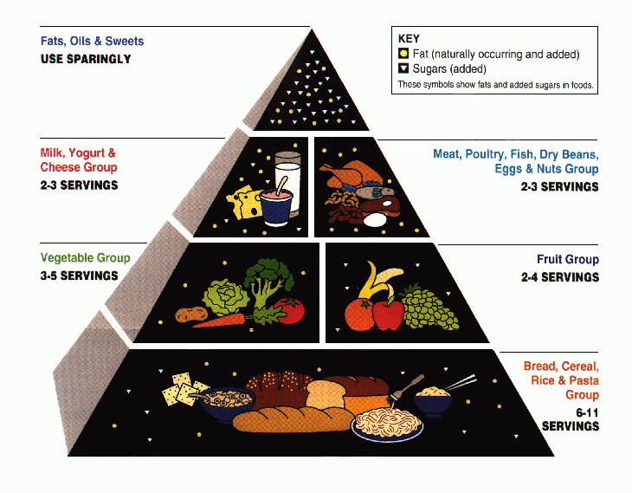
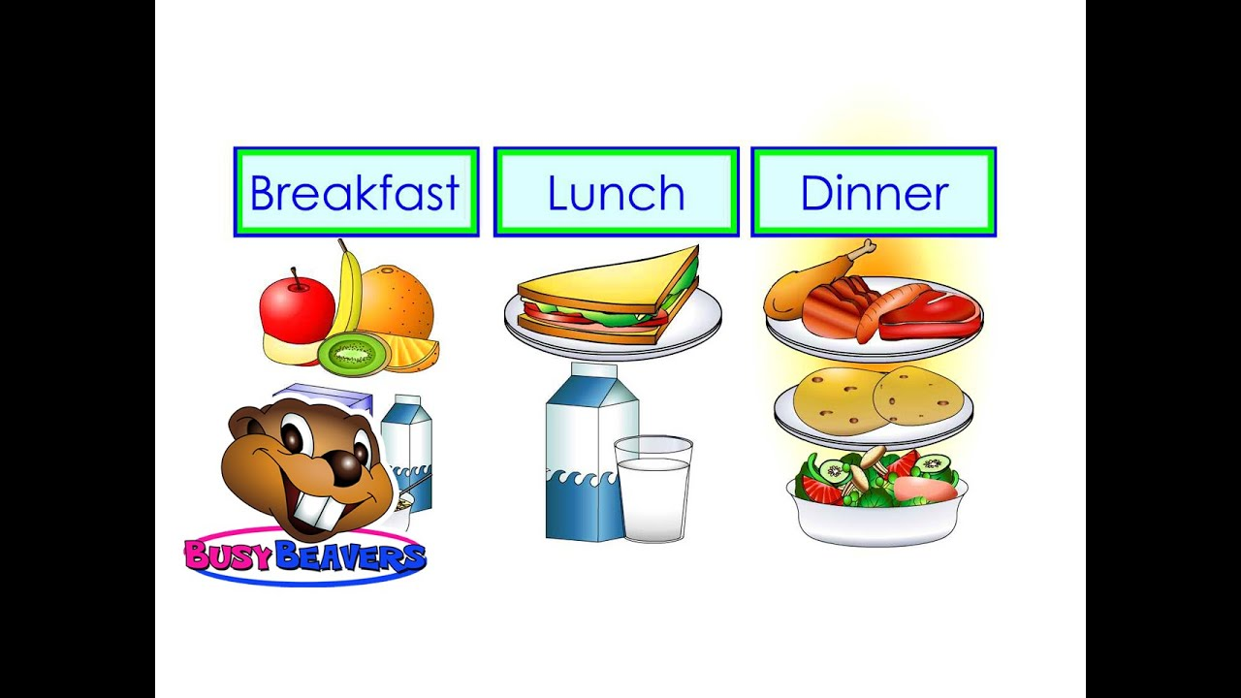
Narrative
World
Medieval Fantasy
Knights, heroes, magic, monsters
Story
Progress through food groups/meals
Final levels, fight the vegan foods
Notes:
The world takes place in a medieval fantasy world, full of heroes and monsters. This supports the story of a chef/knight saving his homeland from encroaching creatures of a culinary origin. This world boosts the idea that an “iron chef” is possible, and would be the best option for defeating food monsters
Progress through different food groups as “level sets”. The player will slowly discover that the vegan tofu foods have been displacing the food monsters. The player will slay the vegan foods as the final set of levels

Slide 8
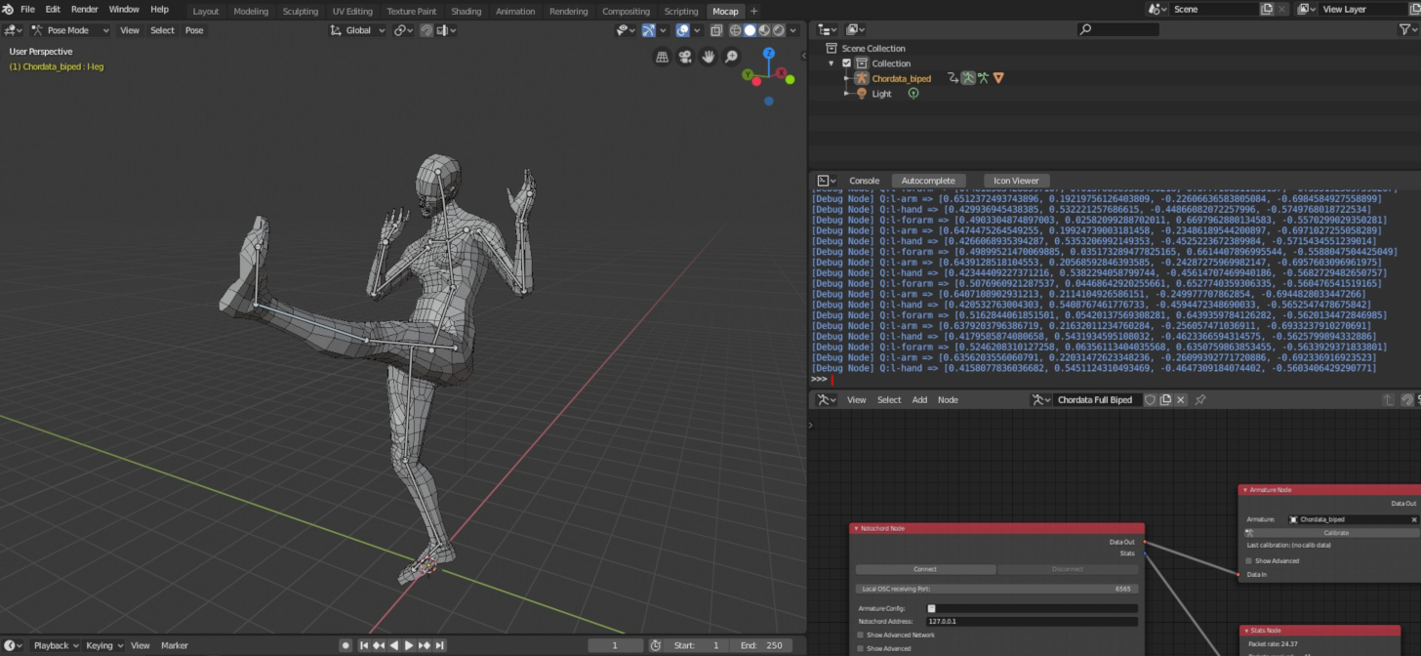
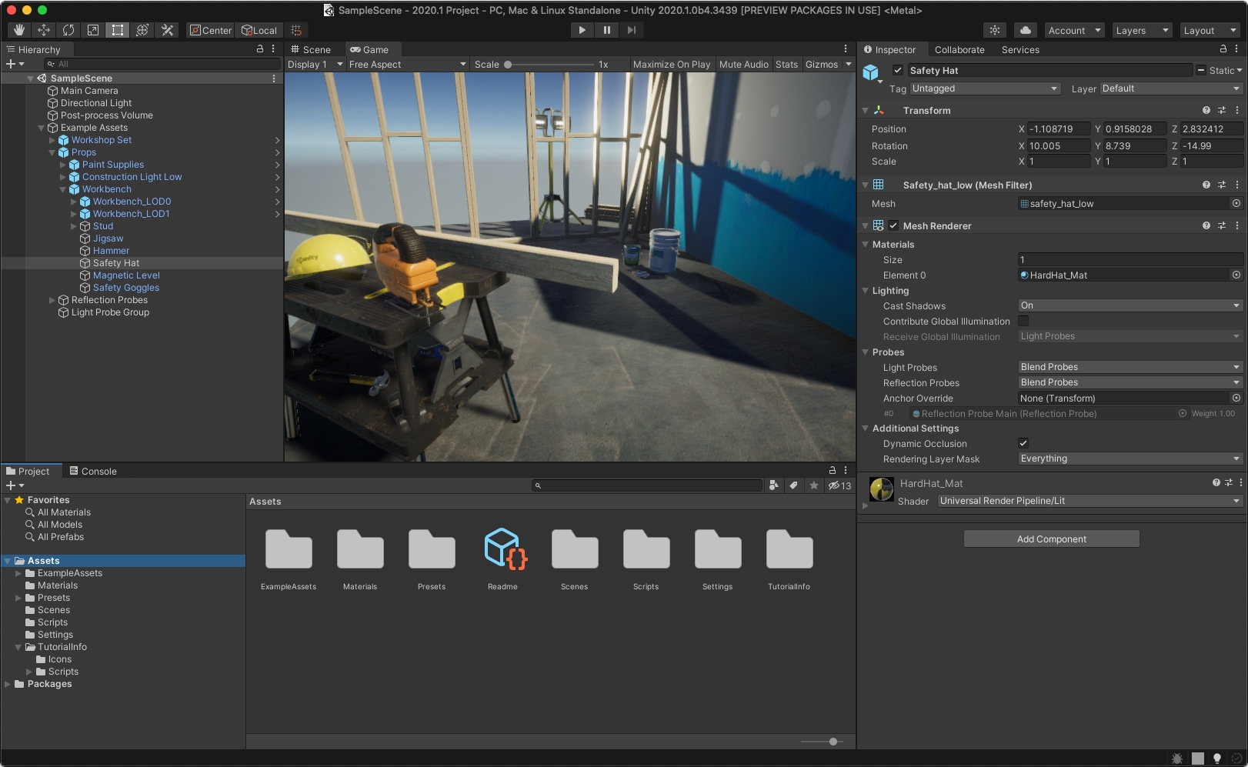
Technology
Unity
Physics
Nav Mesh AI
Cinemachine
Character Controller
Blender/Maya
Preference of the modelers
(Probably Blender)

Slide 9
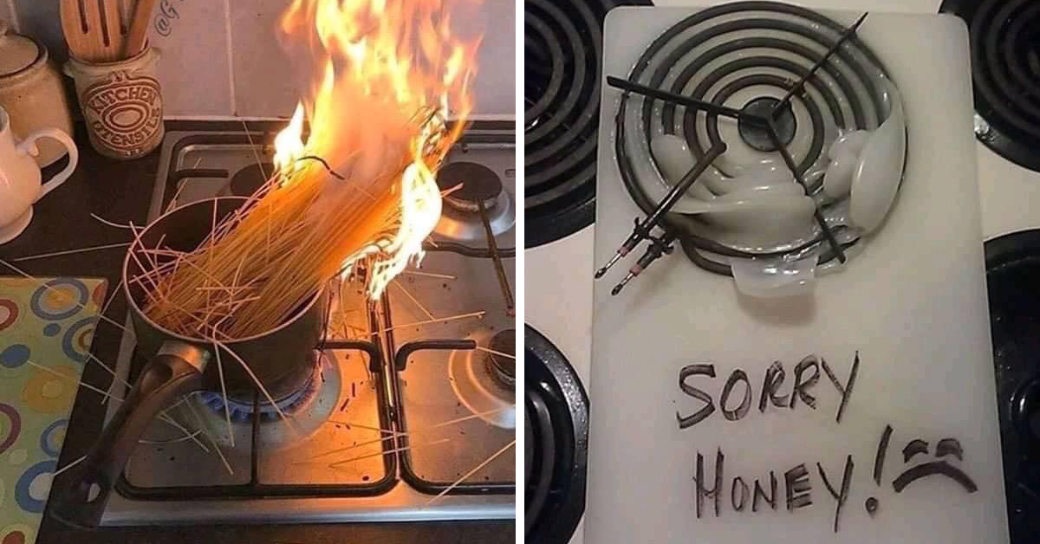
Unique Features
Cooking aspect: Penalty to killing everything you see, be strategic!
Less open world, more level based

Slide 10
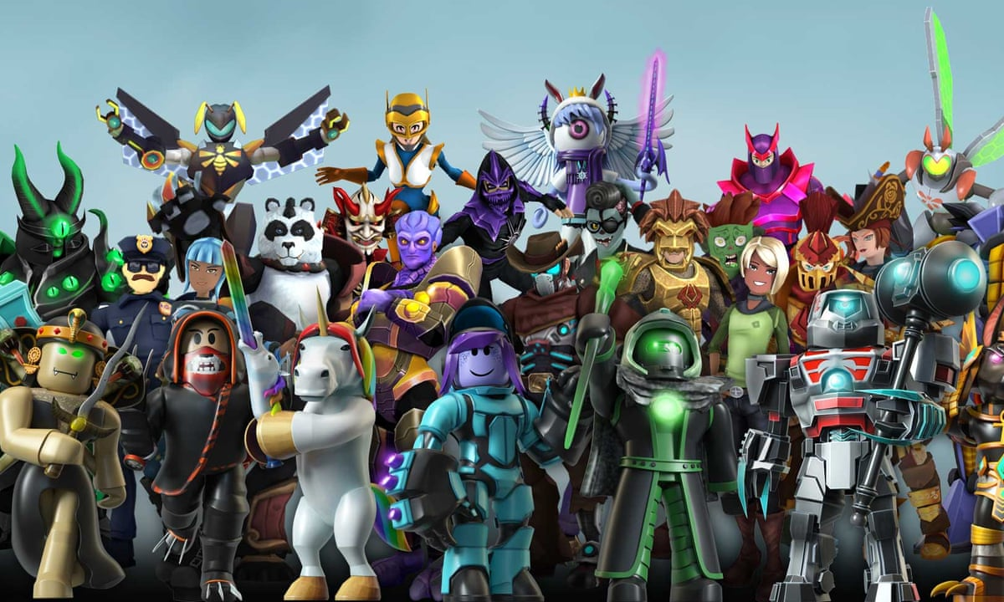
Challenge
Models, models, models

Slide 11
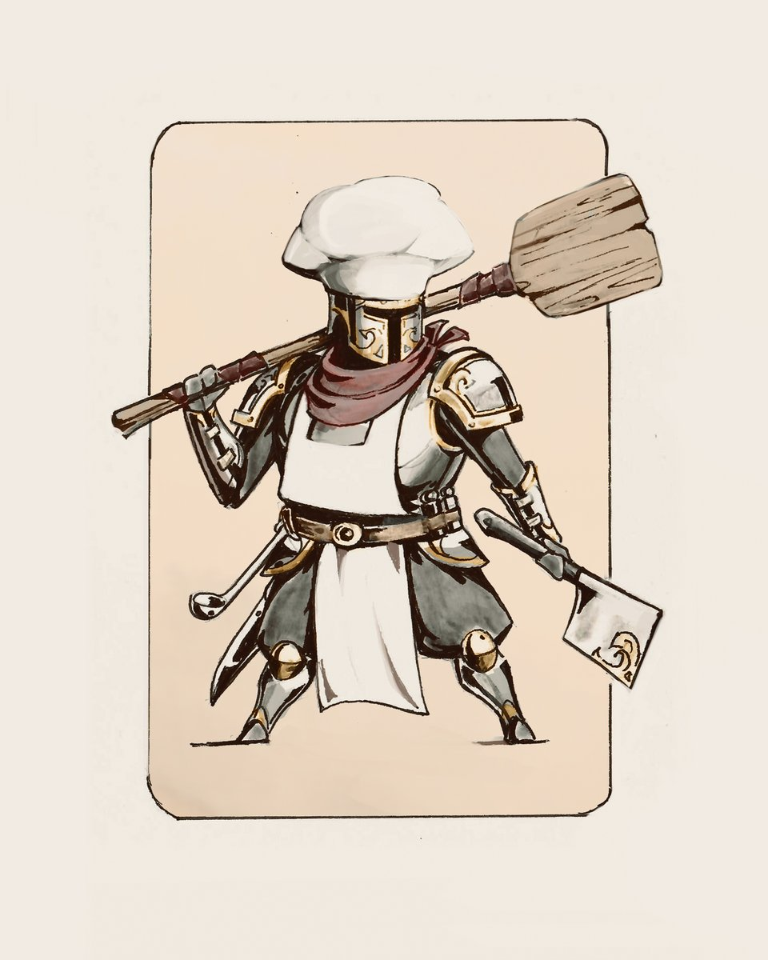
Solutions
KISS method (Keep it simple, stupid)
Reuse of assets
Get a head start

Slide 12
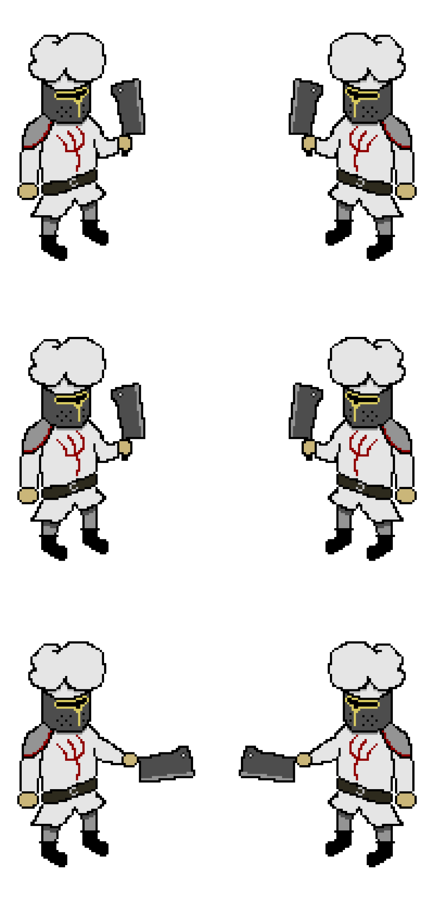
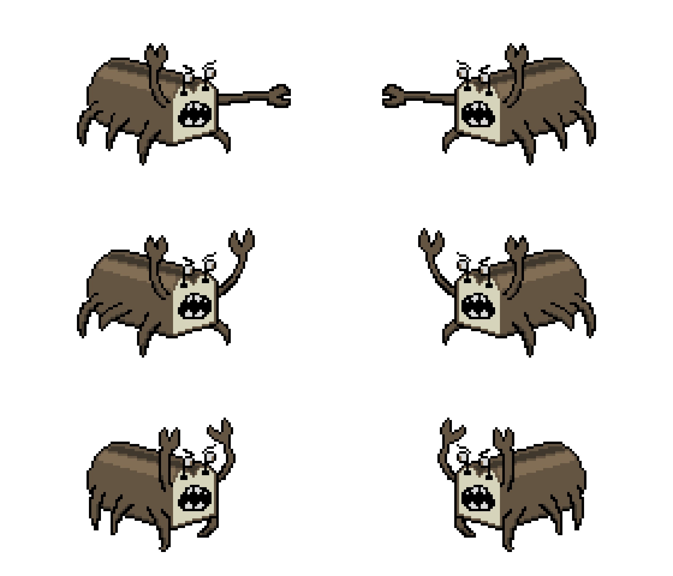

Demo

